Slide 1
The Most (and Least) Valuable States in the U.S.
Sarah Hayes, Sean Lei, Kausik Valeti

Slide 2

Introduction
Objective
Dataset from U.S. Census Bureau’s 2015 American Consumer Survey
State | Value per acre | Median home value | Total value | Total acres | GDP per capita
Bad Graph & article
Notes:
Sean
Objective - to take a poorly designed graph and redesign it by implementing good visualization techniques using R
Article posted by Raul on howmuch.net in 2017
Bad Graph - The article attempts to inform readers about the most and least valuable states in america. This is visually shown by comparing median housing prices and land valuations throughout the U.S.

Slide 3
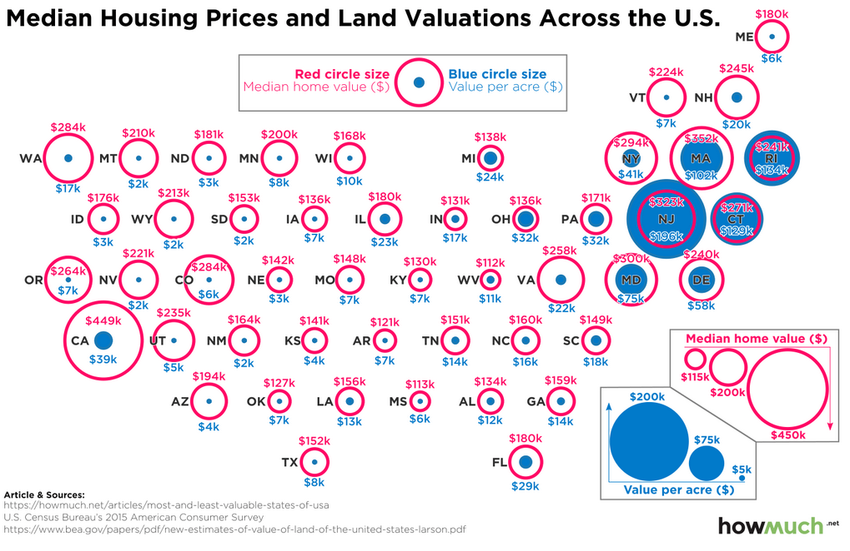
Problems with Bad Graph
Notes:
Sarah - Problems with the bad graph
Comparability
Hard to judge size of circles across the map (e.g. Virginia vs Washington)
Scale of the circles is off - 115 to 200k is 4x the size, as is 200 to 450k
Legend is duplicated
The scale of the two attributes being measured is different
Complexity (over complicated)
Too much information in too small of a space
Blue text in blue circles
Context
Positioning is not perfectly aligned with the location of the states. (Carolinas, Oregon)
Since the shape of states isn’t shown, it’s not as easy to identify what you’re looking for right away
Labels aren’t all consistent
Missing Data
Missing Alaska, Hawaii
Conclusions
home values are positively correlated with population density - population data is not included
Home values are negatively correlated with size of the state - size of state data is not included

Slide 4
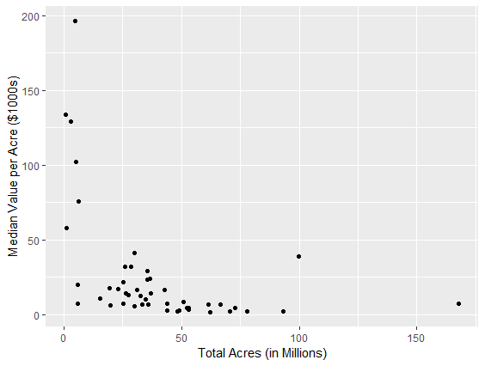
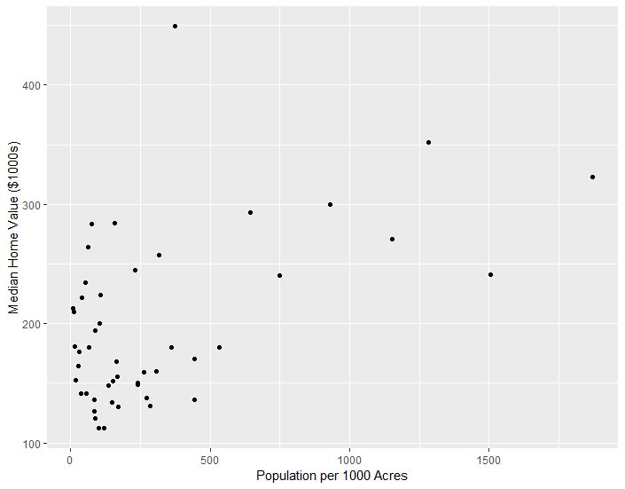
Relationships in Original Conclusions
Notes:
Sarah
Left: address the author’s conclusions on the correlation of land value with area
Right: address the author’s conclusion on the correlation of population density with home value
Author’s text: An acre of land is much more valuable in the Northeast compared to any other part of the country. This is partly because the Eastern seaboard is a very densely populated area with several large cities, most notably New York. It is also a historical artifact that Europeans settled New England first and then moved west, meaning that New York and Massachusetts have some of the oldest modern structures anywhere in the U.S. In other words, Eastern cities are a lot older than Midwestern cities, so there isn’t a lot of farmland for suburban expansion anymore. We should also mention that in terms of geographic size, these are some of the smallest states in the country.
Illustrates the relationships and supports (somewhat) the author’s conclusions, but does not address the purpose based on the title of the article.

Slide 5
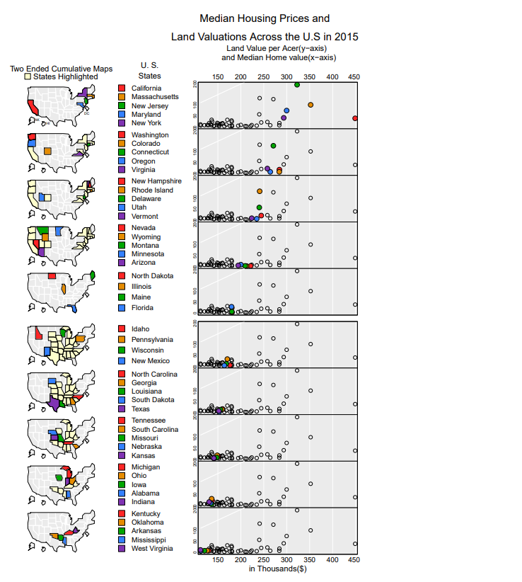
MicromapST
Scatter Plot
Notes:
Kausik

Slide 6
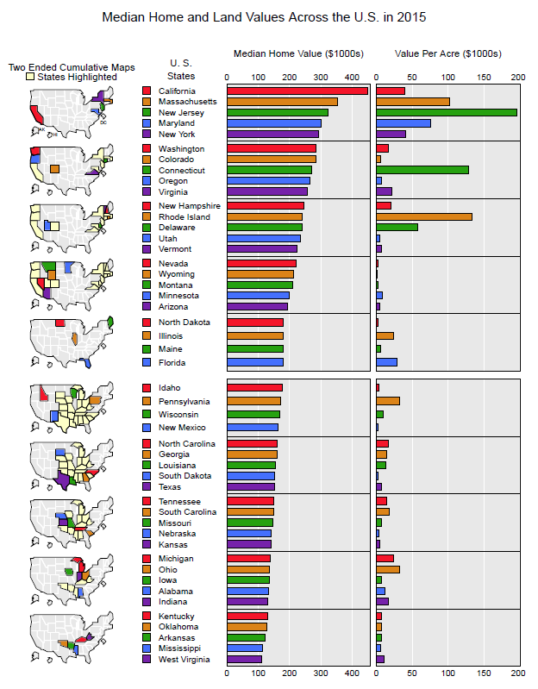
Final Product - MicromapST
Bar Plot
Notes:
Kausik
Linked Micromap that connects the median housing price & value per acre to the corresponding state.
Chose this to easily display geographic information throughout the U.S., which helps to identify geographic trends
Design decisions:
Two ended cumulative maps to show the regions of the top and bottom housing prices to the median
High contrast colors so readers can easily differentiate data
U.S. states fully spelled out to assist readers unfamiliar with geography or abbreviations
Proper labels with unit of measure
Stacked labels so no overlapping
Bars ordered by median housing price, the most important metric to determine state values that can be related to by readers

Slide 7
Conclusion
Corrected Problems with Scaling
Added Visual Representation of States
Sorted Data for Comparability
Simplified Appearance
Notes:
Sean

Slide 8
Next Steps
Complete data by adding Alaska, Hawaii, Washington DC
Update information using 2019 data
Utilize county-level data
Notes:
Sean

Slide 9
Questions

